Slide 1

Final Project Report on
Hand Gesture Recognition
Submitted by
Group No. 5 [Batch: Sep 2019, Location: Chennai]
Group Members
Moturu Praveen Bhargav - GBJALA8ZHP
Christo Thomas - 9EHX3RNJUB
Farid Ahmed - TAZX6XUY0D
Sai Sandeep - LO44VDOBAM
VKS Pavithran - FTE9DUJGJH
Surya Y - 6C2O2GZQPVI
Research Supervisor
Ms Anjana Agrawal
Great Lakes Institute of Management

Slide 2
Final Capstone Project on Hand Gesture Recognition
Praveen Bhargav
Christo Thomas
Farid Ahmed
Sai Sandeep
Pavithran
Surya Y

Slide 3
Industry Overview - Technology Sector
The technology sector is related to the research, development and/or distribution of technologically based goods and services.
This sector contains businesses revolving around the manufacturing of electronics, creation of software, computers or products and services relating to information technology.
The technology sector is often the most attractive investment destination in any economy. The U.S. technology sector boasts of companies like Apple, Google, Amazon, Facebook, Netflix, IBM, and Microsoft.
The global technology industry is approximately worth $5 trillion as of 2019,

Slide 4
Gesture Recognition - Introduction
Gesture recognition is a topic in computer science and language technology with the goal of interpreting human gestures via mathematical algorithms.
Gestures can originate from any bodily motion or state but commonly originate from the face or hand.
Users can use simple gestures to control or interact with devices without physically touching them
Gesture recognition can be seen as a way for computers to begin to understand human body language, thus building a richer bridge between machines and humans than primitive text user interfaces or even GUIs (graphical user interfaces), which still limit the majority of input to keyboard and mouse and interact naturally without any mechanical devices.

Slide 5
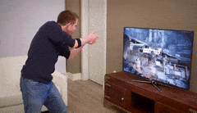
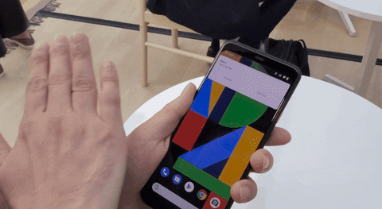
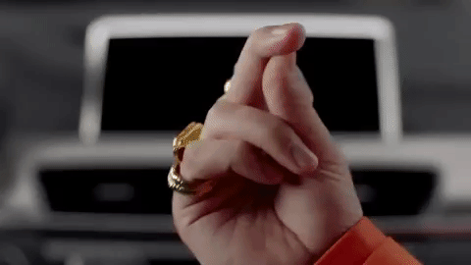
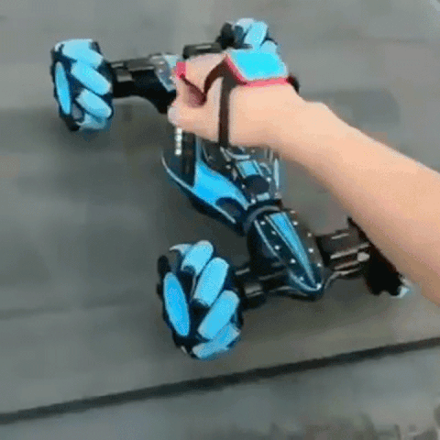
Most Common Hand Gesture Control Use Cases
Interactive Games | User Interfaces in Mobiles/Tablets
Infotainment Systems in Cars | Toys

Slide 6
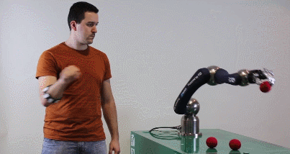
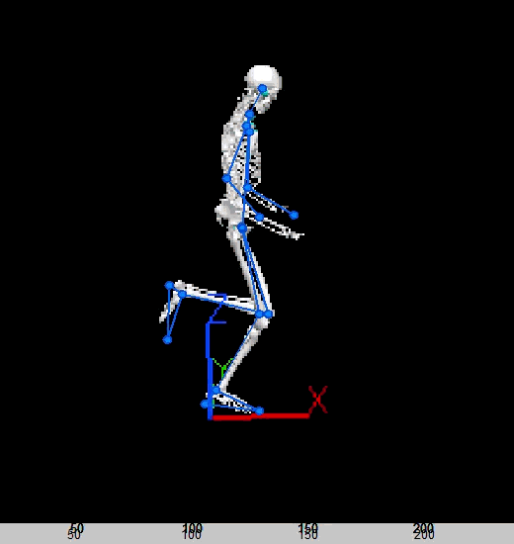
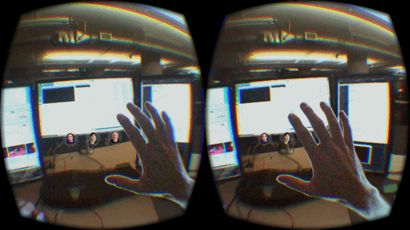
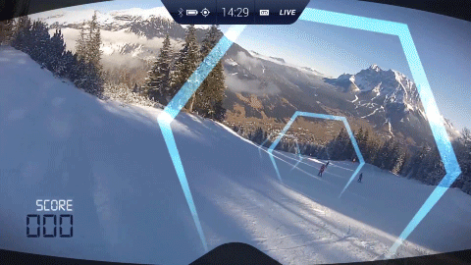
Promising Hand Gesture Control Use Cases
Healthcare – Robotic Arms | Sports Analytics – Training Players
Virtual Reality | Augmented Reality – Training/Simulation

Slide 7
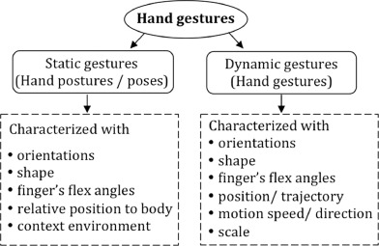
Hand Gesture Pointers

Slide 8
Hand Posture Dataset

Slide 9
Problem Statement :
Gesture recognition for Human Computer Interaction :
There are various applications where hand gesture can be used for interaction with systems. Classical interactions may limit the way we use the system. All these systems require physical contact, in order to interact with system. Gestures can interpret same functionality without physically interacting with the interfacing devices.
Our model is to predict the gesture with utmost precision.

Slide 10
About the data set:
Shape of the data : (78096, 38)
Columns : 'Class', 'User', 'X0', 'Y0', 'Z0', 'X1', 'Y1', 'Z1', 'X2', 'Y2', 'Z2', 'X3', 'Y3', 'Z3’…….. 'X11', 'Y11', 'Z11’.
x, y, z represents the co-ordinates of various markers.
There are 12 markers: 0 to 11
1 at back of glove(1)
3 on thumb(1*3)
2 on each finger( 2*4=8)

Slide 11
There are 14 Users and each user has contributed to 9000 to 10,000 patterns among 5 postures.
Class : Represents the posture of the hand.
1=Fist(with thumb out)
2=Stop(hand flat)
3=Point1(point with pointer finger)
4=Point2(point with pointer and middle fingers)
5=Grab(fingers curled as if to grab).

Slide 12
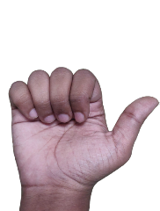
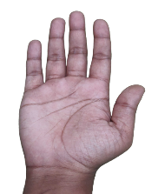
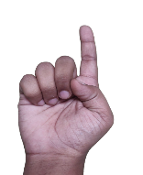
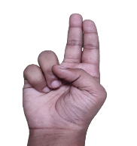
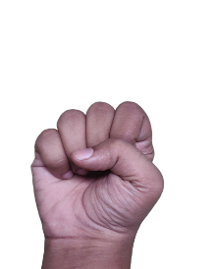
Gestures : Explained
# | Gesture Image | Gesture
1 |  | Fist(with thumb out)
2 |  | Stop(hand flat)
3 |  | Point1(point with pointer finger)
4 |  | Point2(point with pointer and middle fingers)
5 |  | Grab(fingers curled as if to grab).

Slide 13
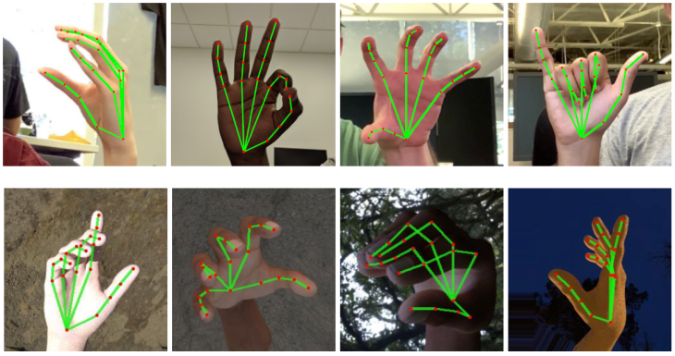
Sample Hand Gestures

Slide 14
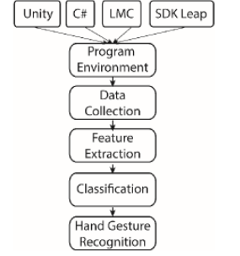
Overall Work Flow

Slide 15
Exploratory Data Analysis
of
Hand Postures

Slide 16
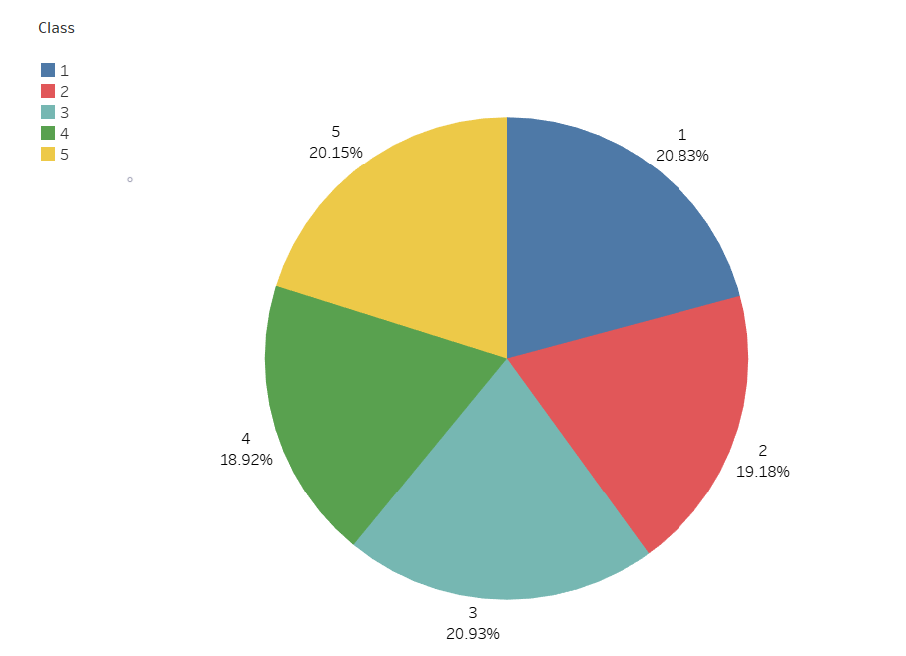
EDA
Pie chart of Class
Number of the records are almost equally distributed among the class

Slide 17
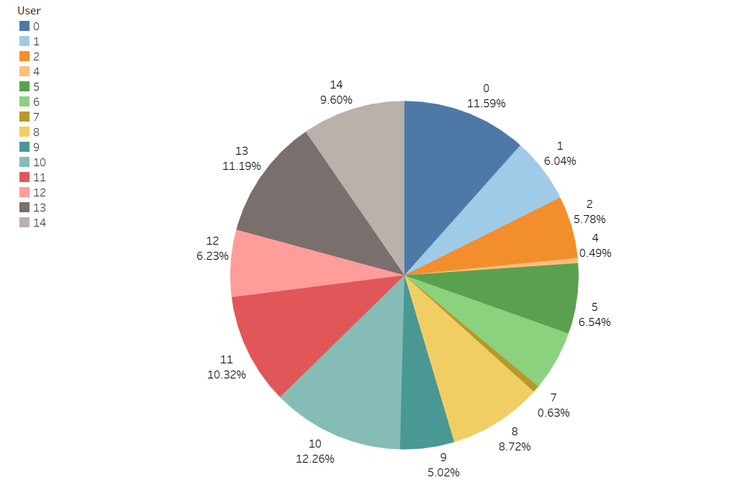
Pie chart about the classes and users
We can see that the user 4 and 7 are having low usage and the user 10 have a higher percentage of 12.26%

Slide 18
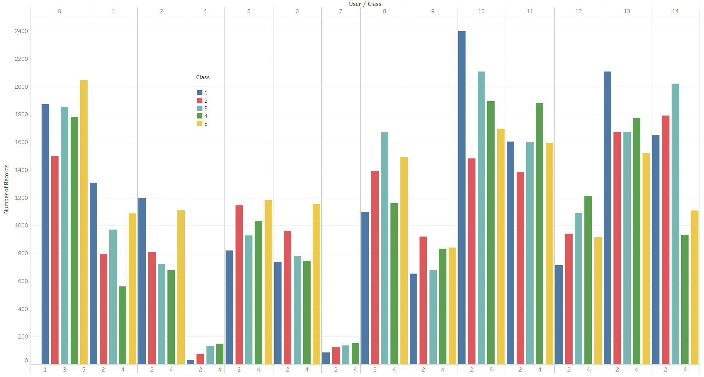
Bar chart
Usage of Class among the Users
We can see that the user 4 and 7 have the number of records are very low comparing which means the user 4 and 7 are less of the hand gestures.

Slide 19
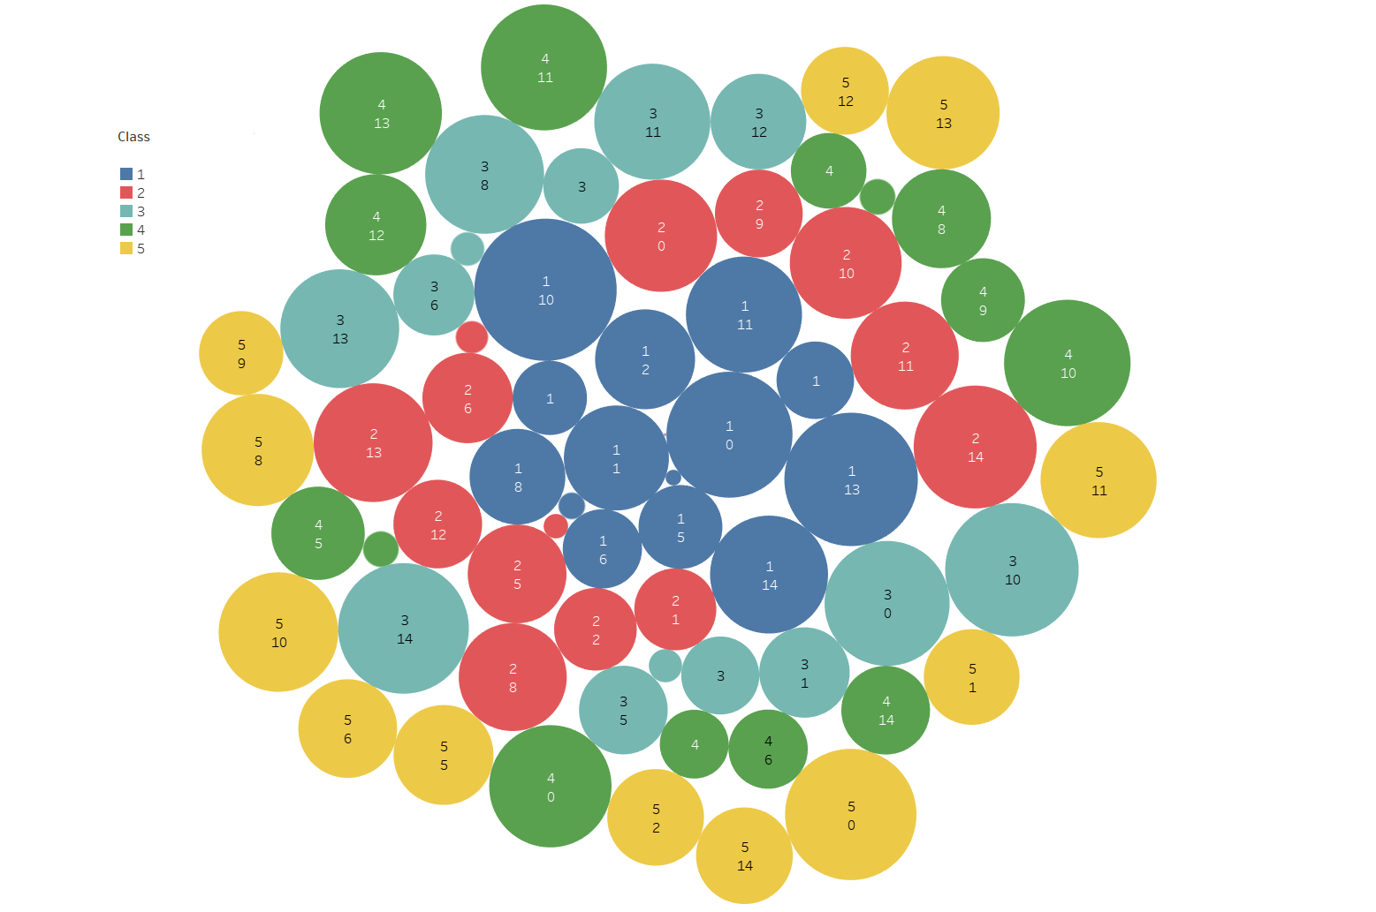
Bubble chart
Here the size represents the number of records and the colour is the class and user is the number.
We can see the small bubbles in the chart which are nothing but a user 4 and 7.

Slide 20
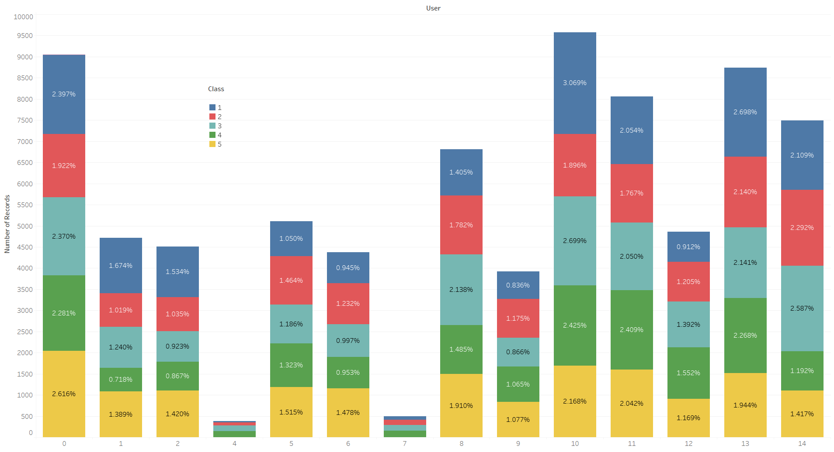
Stacked Bar chart
Here, we can see that the user 10 have the more number of records its above 9500 records and the user 4 and 7 are less then 500 records

Slide 21
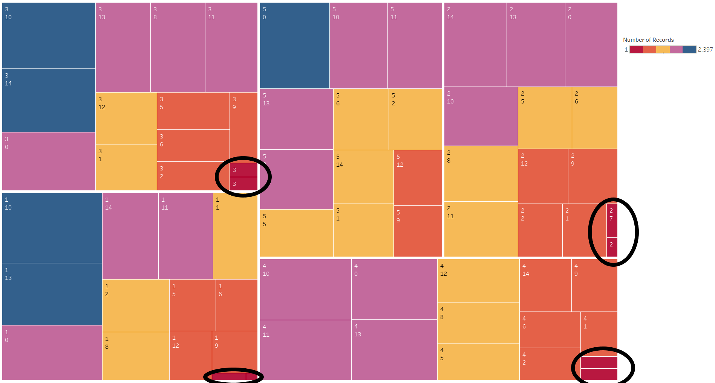
Treemaps
Here, number of records represents the colour and size which means the blue colour is high number of records and red is less number of records.
We can see that the black mark in the chart it highlights the red colour which is nothing but the user 4 and 7.

Slide 22
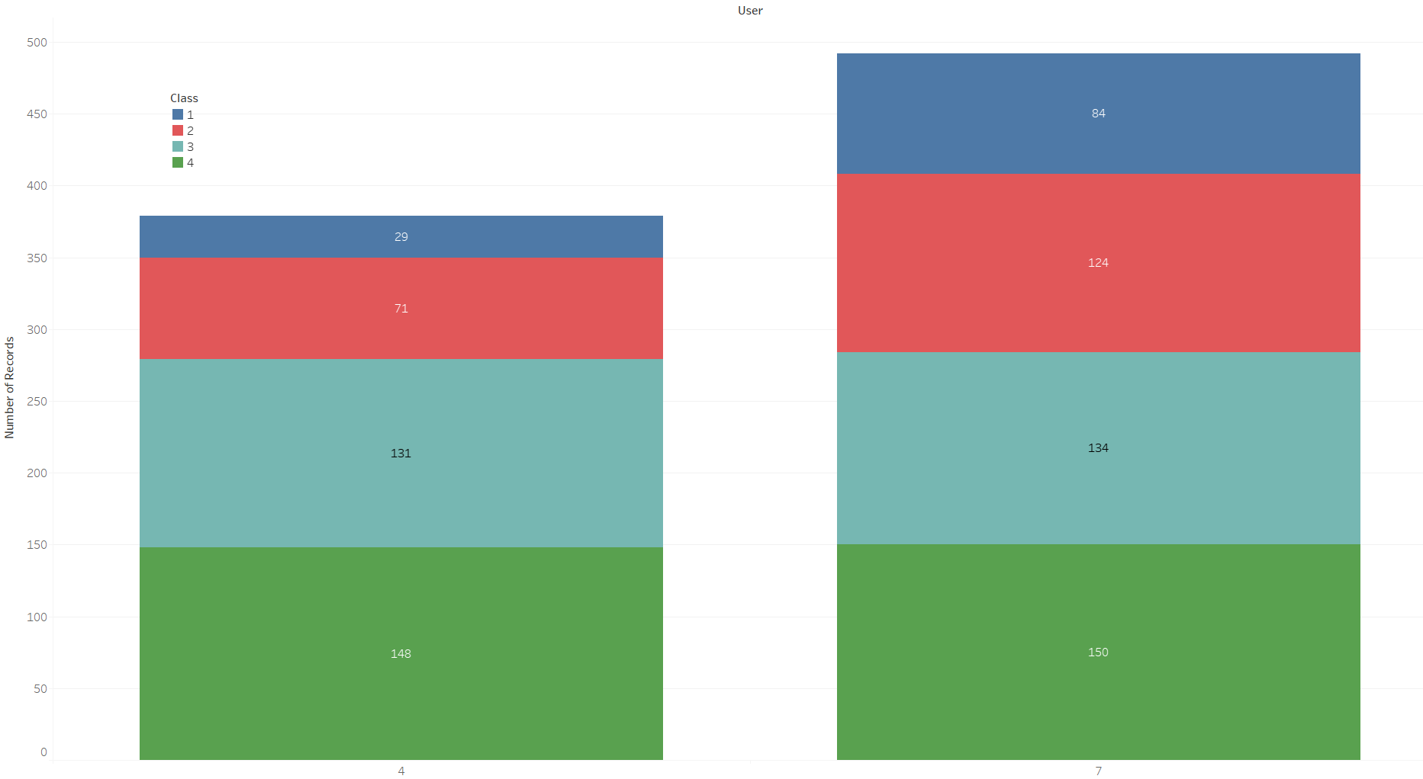
Stacked Bar chart
Here, we took the number of records, user (only 4 and 7) and the class columns to visualize the usage of the each class with respected to the users 4 and 7.
We can see that user 4 and 7 have not used the class 5(Grab gesture )

Slide 23
Model Building

Slide 24
Attempts:
Feature Engineering.
Base models
Logistic Regression
Decision Tree
Random Forest
Naïve Bayes
Applied PCA.
Evaluation of Model with and without PCA.
Parameter Tuning for no._of_Estimators and Learning_rate.
Performing Ensemble Techniques.
Bagging Classifier
AdaBoost Classifier
RandomForest Classifier
Clustering (KMeans) (USL).
Parameter Tuning for optimal number of Clusters.
Evaluation Of Model with and without PCA after USL.
Finalizing the Best rightly fit Model.

Slide 25
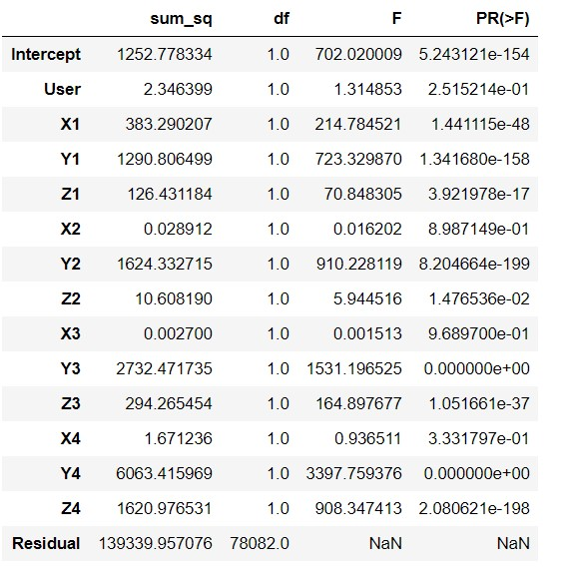
Feature Engineering
To check the significance of each variable, Annova Test has done on few variables.

Slide 26
Reason for not dropping columns
As the all variables are co-ordinates or dimensions of a fingers position, if one variable is removed the dimension will change as a result it may effect the other co-ordinates.
Those indicates the motion of the fingers, one dimension is representing the other.
One dimension is representing the one movement of the finger. If any disturbance occurred in the dimension, the movement in the finger varies.
Ideally the performance metrics will decrease and that is the explanation for not dropping the variables which are not significant.

Slide 27
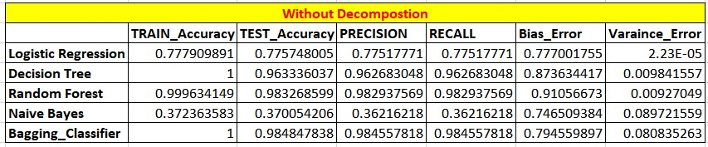
Model Accuracies
Without PCA:
Decision Tree, Random Forest, Bagging Classifier are subjected to High Bias and High Variance.
Naïve Bayes works on all variables to give the conditional probability and also works only on significant variables.
Logistic Regression gives the good accuracy with 77.5% Precision and not suffering with high overfit nor underfit .

Slide 28
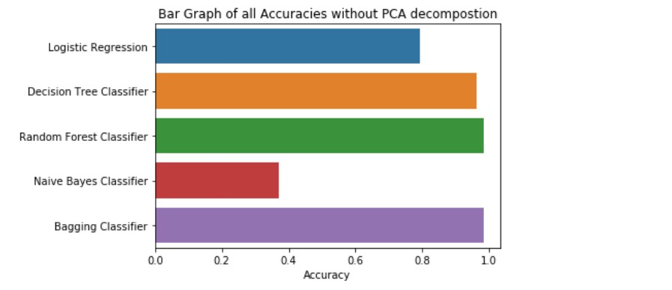
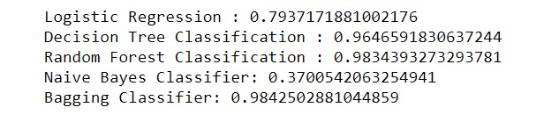
Graphical Representation of Accuracies

Slide 29
Principle Component Analysis
The main idea of principal component analysis (PCA) is to reduce the dimensionality of a data set consisting of many variables correlated with each other, either heavily or lightly, while retaining the variation present in the dataset, up to the maximum extent.
The same is done by transforming the variables to a new set of variables, which are known as the principal components (or simply, the PCs).
The principal components are the eigenvectors of a covariance matrix, and hence they are orthogonal.

Slide 30
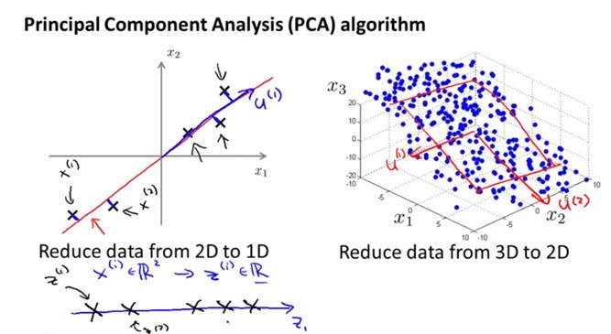
The data which we have the columns are all with continuous values as they are co-ordinates of 12 markers of hand posture of five fingers. So, our data doesn’t need to scale when applying PCA side by the existence of multi collinearity is less, we are applying PCA to reduce the columns and the complexity of the model.

Slide 31
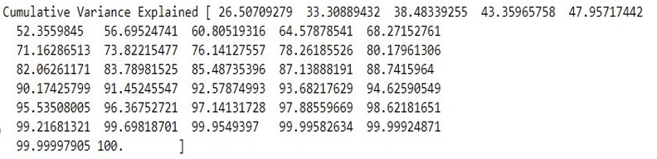
Choosing Principal components
We order the eigenvalues from largest to smallest so that it gives us the components in order or significance.
If we have a dataset with n variables, then we have the corresponding n eigenvalues and eigenvectors. It turns out that the eigenvector corresponding to the highest eigenvalue is the principal component of the dataset and it is our call as to how many eigenvalues we choose to proceed our analysis with.
To reduce the dimensions, we choose the first 30 eigenvalues and ignore the rest. We do lose out some information in the process, but if the eigenvalues are small, we do not lose much.

Slide 32
Forming A Feature Vector And New Data
We form a feature vector which is a matrix of vectors, in our case, the eigenvectors.
In fact, only those eigenvectors which we want to proceed with.
In the case of 2 dimensions in the running example, we can either choose the one corresponding to the greater eigenvalue or simply take both.
Feature Vector = (eig₁, eig₂)
Forming Principal Components:
We take the transpose of the feature vector and left-multiply it with the transpose of scaled version of original dataset.
NewData = FeatureVector^{T} x ScaledData^{T}
Here,
NewData is the Matrix consisting of the principal components,
FeatureVector is the matrix we formed using the eigenvectors we chose to keep, and ScaledData is the scaled version of original dataset

Slide 33
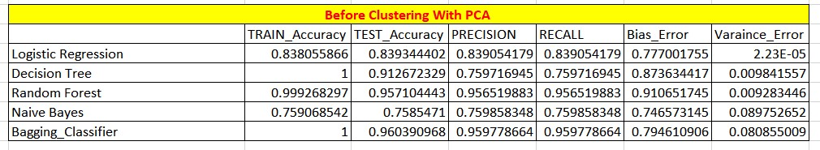
With PCA
The no. of principal components used after PCA is 30 out of 37 components, so that the complexity of the models will decrease a little.
The no. of estimators used here in Random Forest is 12.
We consider the best model is Logistic Regression as it’s not overfitted nor underfitted with having balance in Bias and Variance Errors.

Slide 34
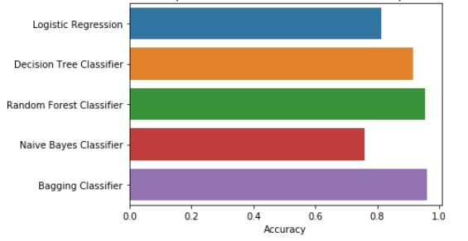
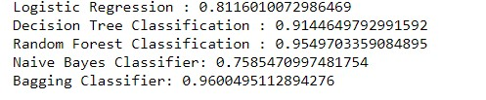
Graphical Representation of all Model’s Accuracies

Slide 35
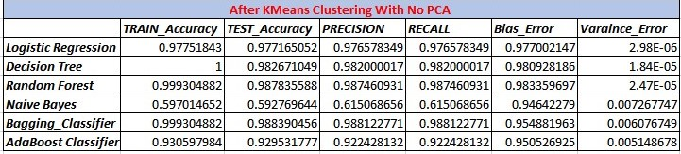
KMeans Clustering
The optimum number of clusters selected is 3 from KMeans Clustering.

Slide 36
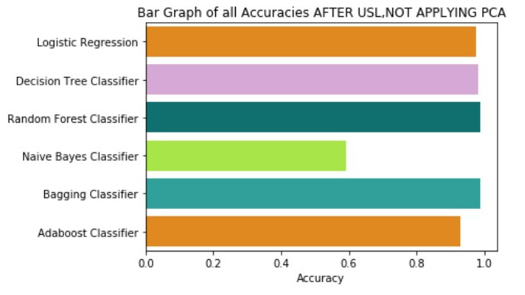
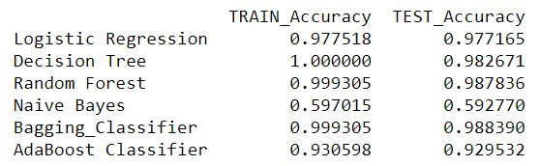
Pictorial Representation of all Accuracies

Slide 37
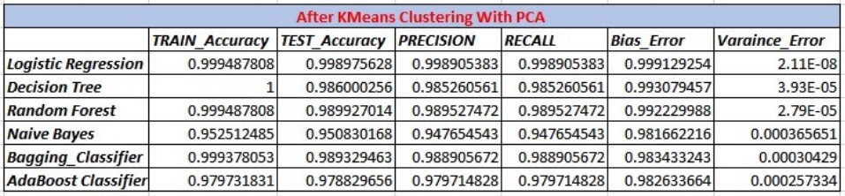
KMeans With PCA
The optimum number of Estimators were taken for Bagging Classifier is 85
The optimum number of Estimators were taken for AdaBoost Classifier is 5 with learning rate 1.

Slide 38
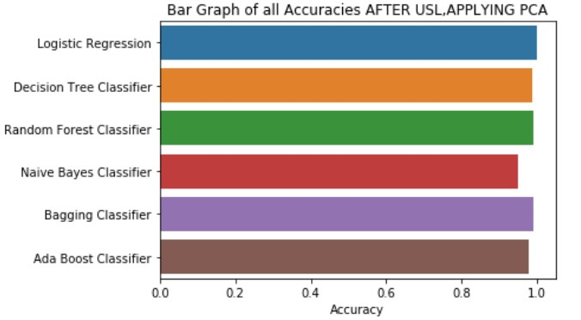
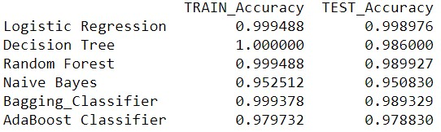
Graphical Representation of all model’s accuracies

Slide 39
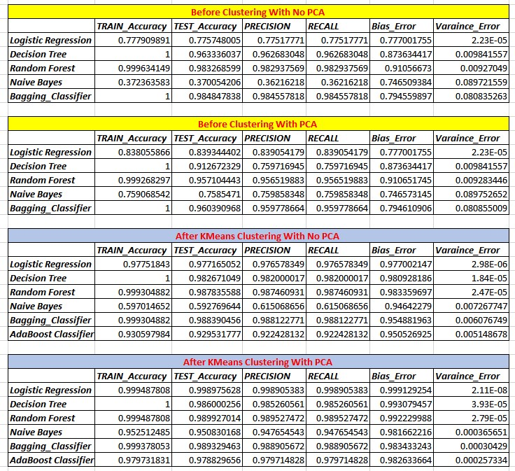
Overall Accuracies of all Models

Slide 40
Final Model
Thus applying the PCA with Logistic Regression shows the better accuracy without highly biased, not having high variance error , neither highly overfitted nor underfitted, since it is having a high precision accuracy value, we prefer the Logistic Regression Model after Applying PCA for this Data Set.
Model | TRAIN_ACC | TEST_ACC | PRECISON | RECALL | BIAS_ERR | VAR_ERR
Logistic | 0.83805586 | 0.839344 | 0.8390541 | 0.8390541 | 0.7770017 | 0.0000223

Slide 41
Industries researching on Hand Gesture Recognition
Health sector
Automobile sector
Consumer Electronics sector
Manufacturing sector

Slide 42
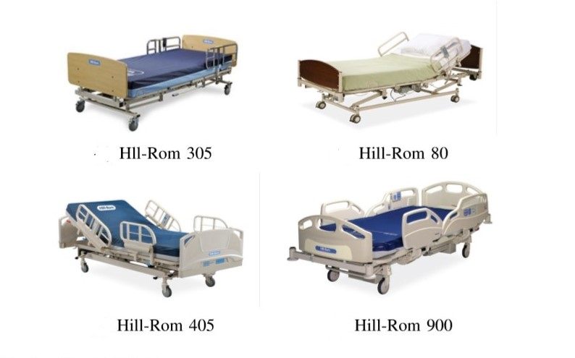
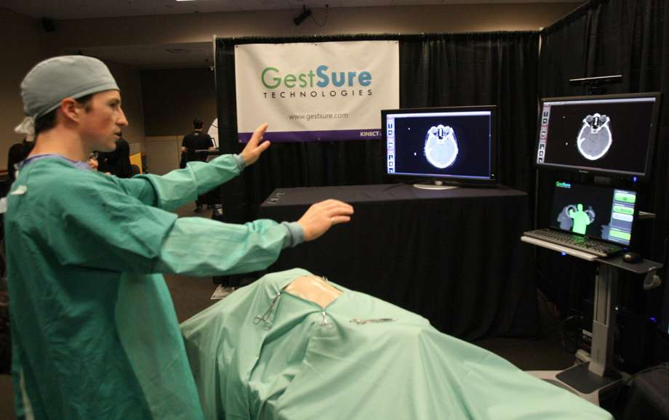
Health Sector

Slide 43
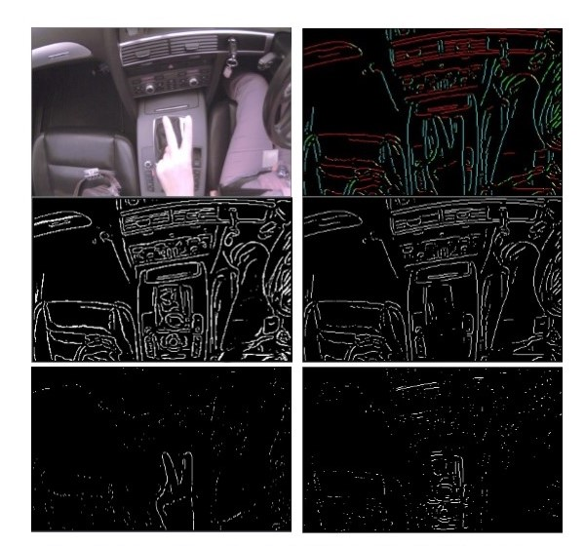
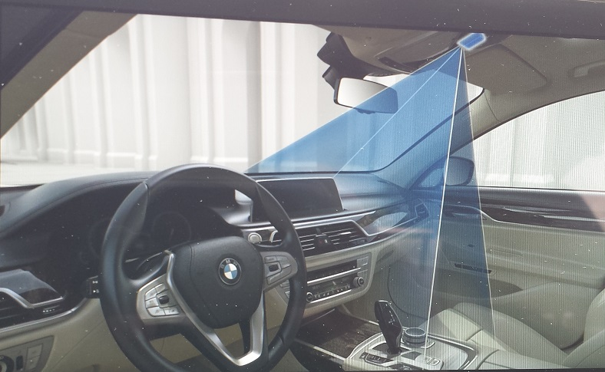
Automobile Sector

Slide 44
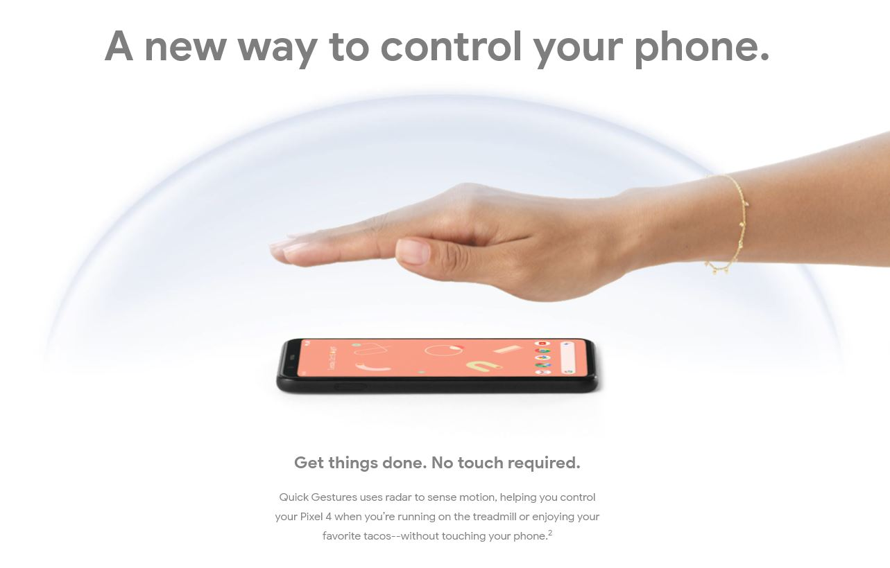
Consumer Electronics Sector

Slide 45
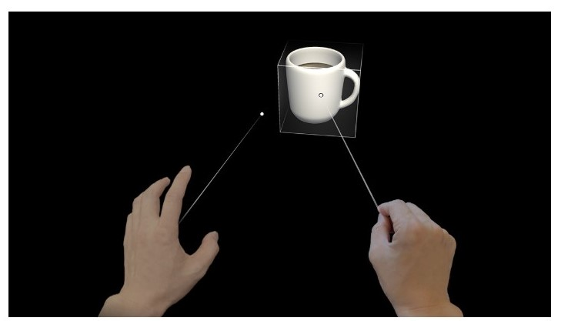
Holograms (Mixed Reality platform)

Slide 46
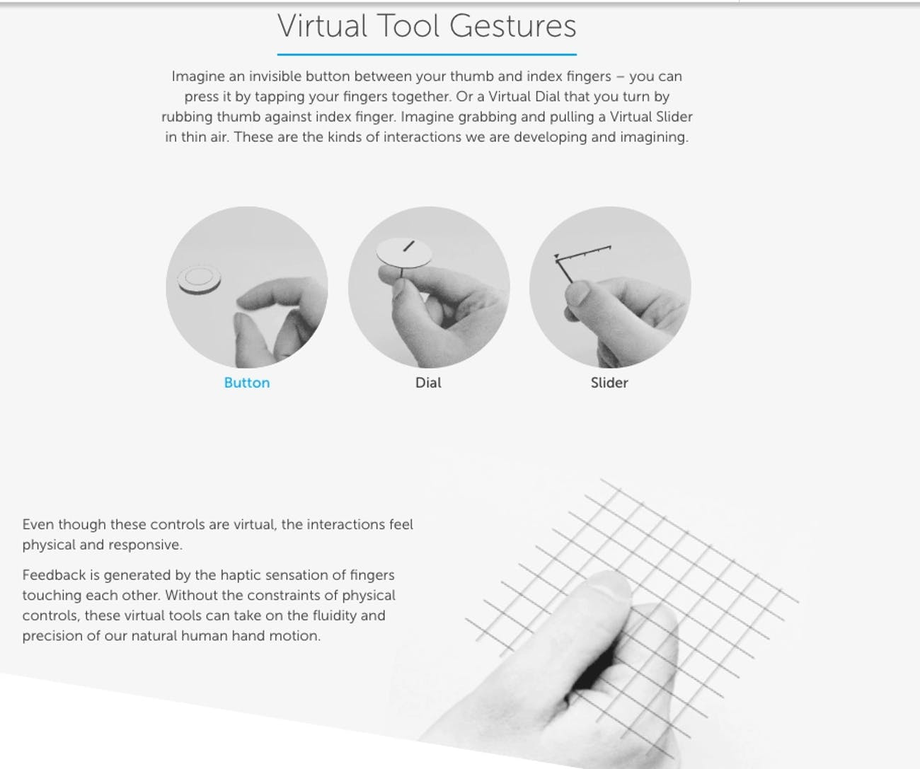
Virtual Tool Gesture.

Slide 47
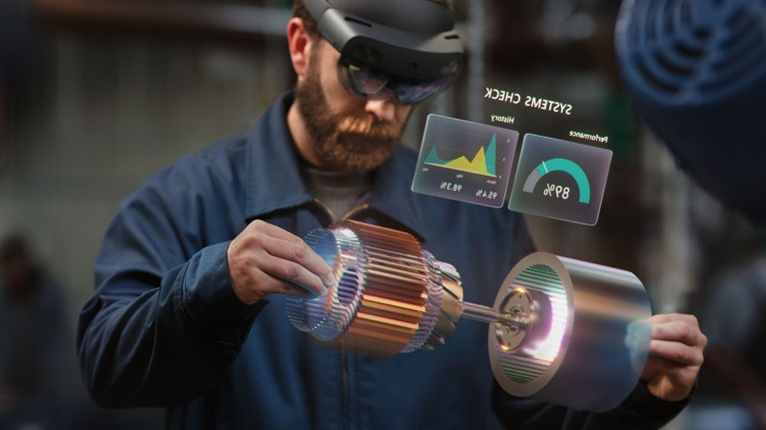
Machinery study and manufacturing. Increase speed of work.

Slide 48
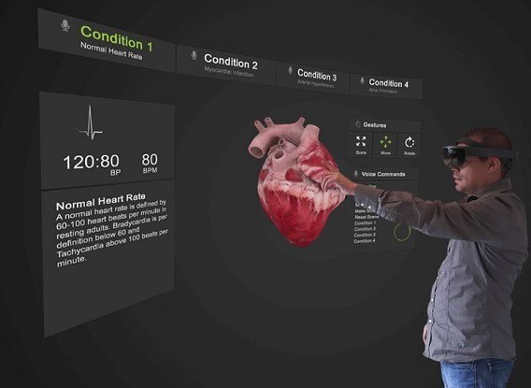
Improving patient care. Better understanding of diseases and symptoms. Creating a virtual environment for medical practitioners.

Slide 49
Business Insights Health sector:
Hospitals In USA has a loss of $8.3 billion because of older and outdated communication methods and technology.
These hospitals when they adapt to the new technology with hand gestures there are better possibilities to understand the disease and diagnosis with proper procedures.
These hand gestures when applied to beds and wheelchairs will give a better communications between the patient and the doctor where we can control the lose of life.

Slide 50
Automobile and Manufacturing :
A 2016 survey found that U.S. Machinery and Automobile Manufacturing Industries lose up to $1.8 billion each year in wasted productivity due to obsolete technology.
These Industries when they introduce automation and AI, There production rate will be increased with less time than before.
These technologies will give better understanding of the machinery which will help in maintaining and upgrading the machineries.

Slide 51
THANK YOU

